Slide 1
Manual Testing
Gopi Muruganantham

Slide 2
Agenda
SDLC Process
Testing & it's Importance
Principles Of Testing
Software Testing Levels
Characteristics Of a Good Test Case
Inputs Required For Test Case Preparation
Effective Unit Test Case
Unit Test Case Template
Test Case Preparation
Defect Control Form
Traceability Matrix
Points To Remember

Slide 3
SDLC Process
Software Development Life Cycle is a process used by software industry to design, develop and test high quality software The SDLC aims to produce a high quality software that meets or exceeds customer expectations, reaches completion within times and cost estimates.

Slide 4
SDLC Process
SDLC is the acronym of Software Development Life Cycle.
It is also called as Software development process.
The software development life cycle (SDLC) is a framework defining tasks performed at each step in the software development process.
The life cycle defines a methodology for improving the quality of software and the overall development process.

Slide 5
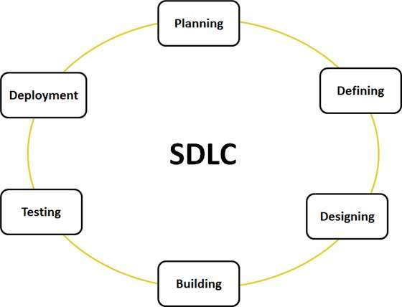

Slide 6
Testing & It's Importance
Software testing is a process used to identify the correctness, completeness, and quality of developed computer software. It includes a set of activities conducted with the intent of finding errors in software so that it could be corrected before the product is released to the end users.
In simple words, software testing is an activity to check whether the actual results match the expected results and to ensure that the software system is defect free.

Slide 7
Importance...
To ensure that what we create does what it’s supposed to do.
Something that works when one person is using it may not work when hundreds of people are using it.
There are lots of different devices, browsers, and operating systems out there.
We owe it to our users and ourselves to deliver the best application we can.

Slide 8
Principles of Testing
Test a program to try to make it fail
Start testing early
Testing is context dependent
Define test plan
Design Effective Test Cases
Test for valid as well as invalid conditions
Review test cases regularly

Slide 9
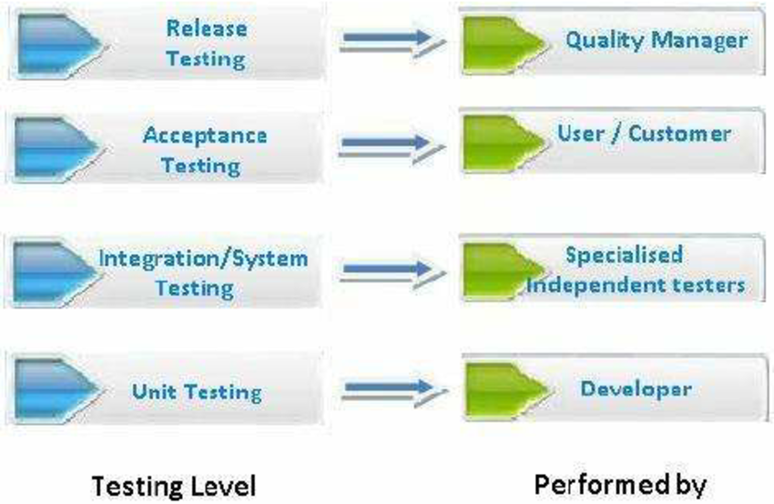
Software Testing Levels

Slide 10
Characteristics Of A Good Test Case
It has a reasonable probability of catching an error
It is not redundant
It’s neither too simple nor too complex
It makes program failures obvious
It must completely verify that the requirements are met
It should cover conditions based on error guessing.

Slide 11
Inputs Required for Test Case Preparation
System Test Case – System Requirement Specification (SRS Or CRS)
Integration Test Case – High Level Design Documents, Entity Relationship Diagram (ERD)
Unit Test Case – Program Specification Or Functional Specification (PS Or FS)

Slide 12
What should be included in a Test Case?
The main logic or functionality of the screen
Business rules
Integration rules
Processing logic
Functionality of all buttons/options available in the screen
Boundary conditions
Values saved in the database
Field validations based on field type
GUI Validations

Slide 13
Effective Unit Test Case
Maximum Coverage can be achieved, if the conditions are written in the following order: (For testing of screens)
On screen Load
Business Logic
Field Validations
GUI Validations
Security

Slide 14
Test Case Preparation
A Test Case is a particular scenario developed for testing purpose. In simple words Test Case is a combination Of Test Conditions
It includes:
A condition
Set of input values for each condition
A set of expected output values for comparison purposes
Any additional required validation procedures

Slide 15
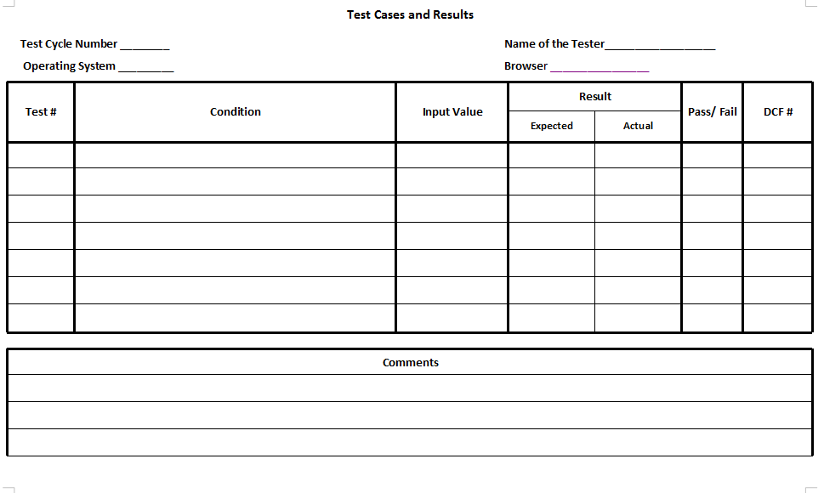
Unit Test Case Template

Slide 16
All Text Fields are left aligned, all numeric and currency fields are right aligned and all date fields are center aligned
Condition | Input | Expected Result
Check for the alignment text in the text fields | NA | Values in the text fields should be left aligned
Check for the alignment values in numeric & currency fields | NA | Values in the numeric & currency fields should be right aligned
Check for the alignment of date in the Date field | NA | The date displayed should be center aligned by default

Slide 17
Money values are formatted based on setup in the database. Symbol Prefix are $, Rs etc. Format Pattern can be Eastern or Western this determines the formatting to be done as Millions or Lacks. Format Symbol specifies the symbol used to format the real value “,” or “.”.

Slide 18
Condition | Input | Expected Result
Check for the symbol prefix of the money value in the currency fields | Select the currency and enter numeric value in the currency field (e.g. 100) | The money value entered should have a symbol prefix (Rs,$ )based on the prefix defined for selected currency
Check for the format pattern of the money values | Enter any large real value in the currency field | The formatting should be done based on the format pattern defined (eastern or western) For eg. Format can be 19,05,000.50 or 190,500,0.50
 | NA | The real and decimal value should be separated based on the symbol specified.

Slide 19
At any point of time, there can be only one child window opened for a parent window and parent window cannot be closed when child window is open.
Condition | Input | Expected Result
Check for the number of child windows that can be open in one instance | Open a child window from a parent window. Try to open one more window | Application should not allow to open one more window
Check for the closing of the parent window when child window is open | Open a child window from a parent window. While child window is open try to close the parent window. | Application should not allow to close the parent window

Slide 20
Field Validations
Condition | Input | Expected Result
Check for the mandatory nature of the Project Id field | Leave the field blank and click on save option | An appropriate error message should be displayed
Check for the boundary conditions of the Project ID field | Enter alphanumeric value of length <=15 | The entered value should be accepted
 | Enter alphanumeric value of length >15 | The field should not accept more than 15 characters
Check that the value entered in the project id field is converted to uppercase | Enter a valid value in the Project id field and shift the focus to next field | The value entered in the field should be displayed in upper case

Slide 21
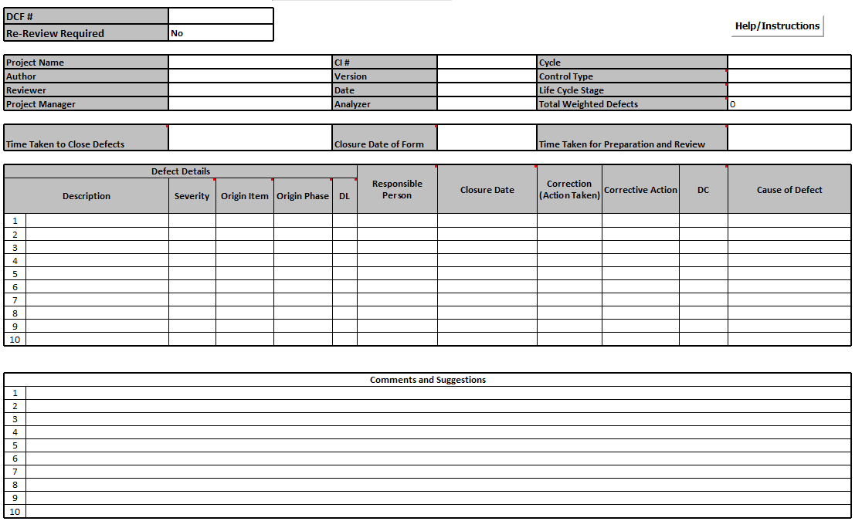
Defect Control Form

Slide 22
Software Defect
A Software Defect / Bug is a condition in a software product which does not meet a software requirement (as stated in the requirement specifications) or end-user expectations (which may not be specified but are reasonable).
In other words, a defect is an error in coding or logic that causes a program to malfunction or to produce incorrect/unexpected results.

Slide 23
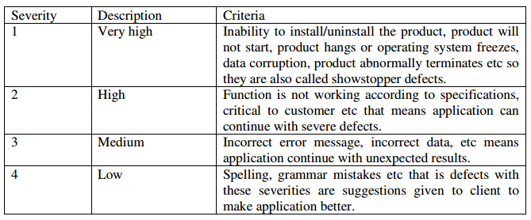
Severity of defects

Slide 24
Traceability Matrix
The Requirements Traceability Matrix (RTM) is a document that links requirements throughout the validation process.
The purpose of the Requirements Traceability Matrix is to ensure that all requirements defined for a system are tested in the test protocols.
The traceability matrix is a tool both for the validation team, to ensure that requirements are not lost during the validation project, and for auditors, to review the validation documentation.

Slide 25
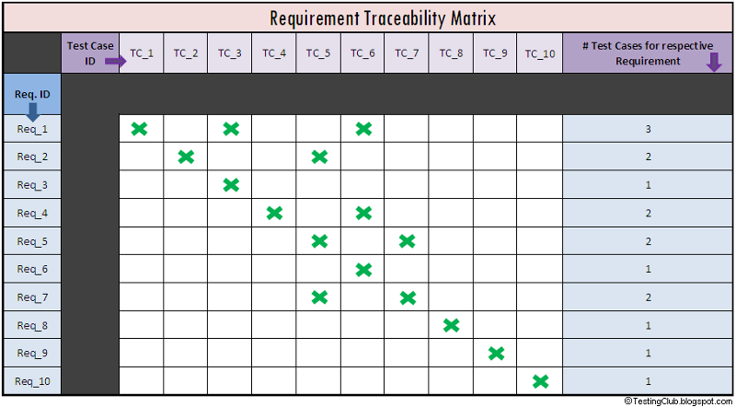

Slide 26
Requirements Traced To Database Tables

Slide 27
Points To Remember
“A mistake in coding is called error ,error found by tester is called defect, defect accepted by development team then it is called bug ,build does not meet the requirements then it is failure.”
A program that contains a large number of bugs is said to be buggy.
Reports detailing bugs in software are known as bug reports.
The process of finding the cause of bugs is known as debugging.
Verification: Are we building the product right? ( Software must conform to its specification )
Validation: Are we building the right product? ( Software should do what the user really requires )

Slide 28
Thank you

